Slide 1
UHP-F5-630 Fast Pulses
Measurement Instruments:
Photo-receiver: Newfocus 2051 (Settings: BP Filter DC-5MHz GainA=1, GainB=1)
Function Generator: Tektronix AFG1022 (Settings: TTL out 5V/0V)
Prizmatix

Slide 2
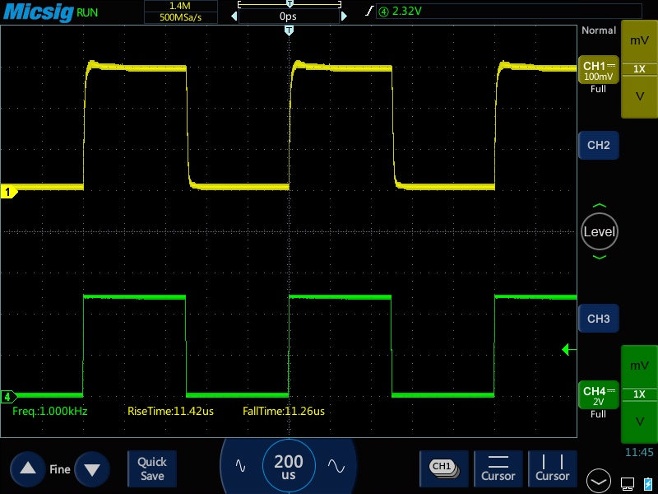
Standard Board: Freq: 1kHz, Duty Cycle: 50%
Ch1: Photosensor
Ch2: TTL input
Prizmatix

Slide 3
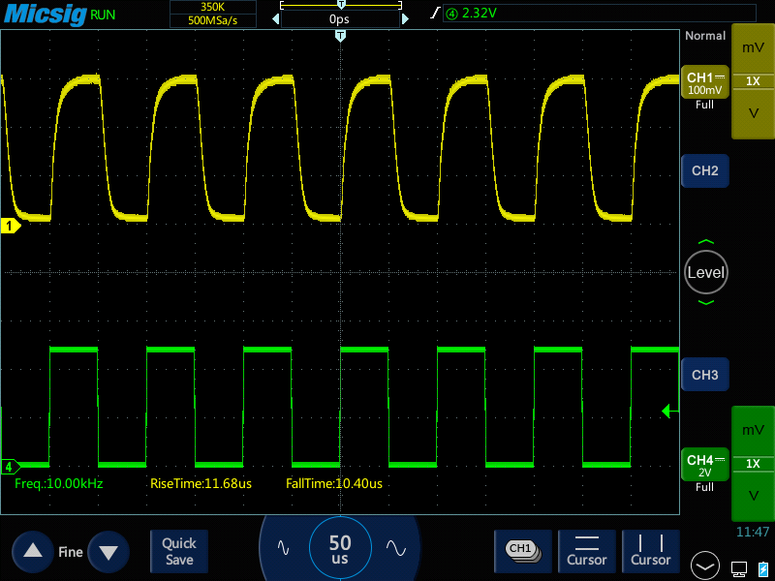
Standard Board: Freq: 10kHz, Duty Cycle: 50%
Ch1: Photosensor
Ch2: TTL input
Prizmatix

Slide 4
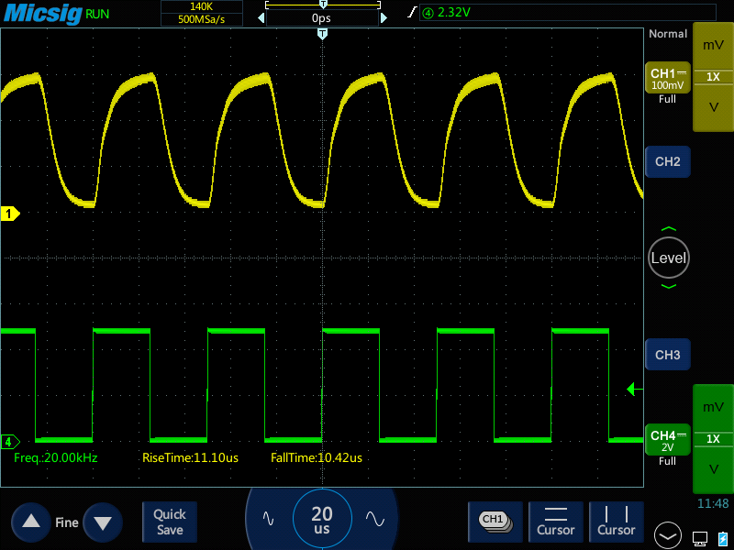
Standard Board: Freq: 20kHz, Duty Cycle: 50%
Ch1: Photosensor
Ch2: TTL input
Prizmatix

Slide 5
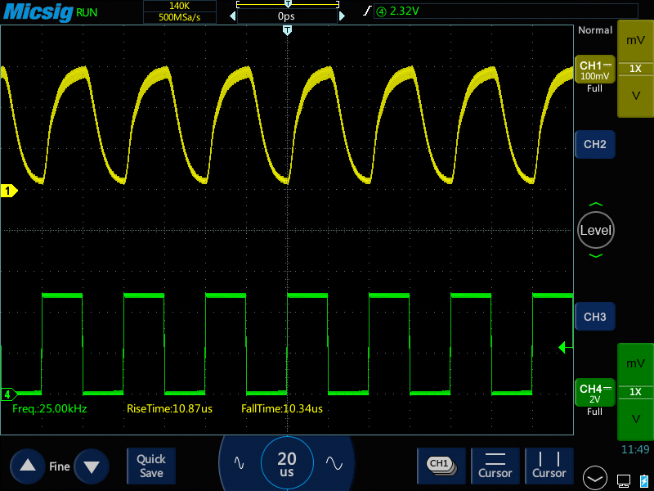
Standard Board: Freq: 25kHz, Duty Cycle: 50%
Ch1: Photosensor
Ch2: TTL input
Prizmatix

Slide 6
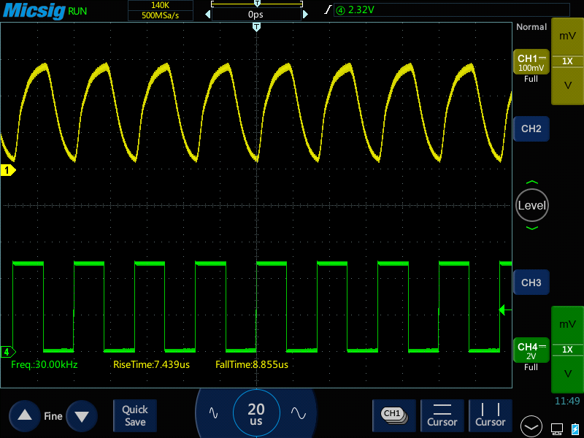
Standard Board: Freq: 30kHz, Duty Cycle: 50%
Ch1: Photosensor
Ch2: TTL input
Prizmatix

Slide 7
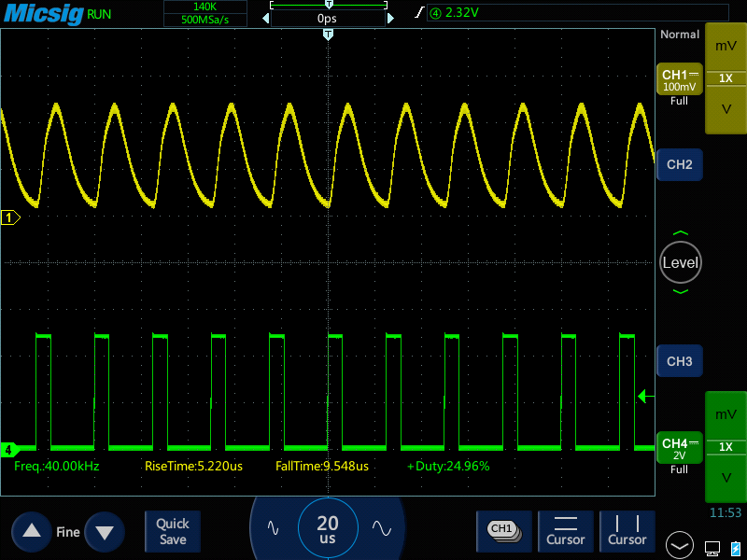
Standard Board: Freq: 40kHz, Duty Cycle: 25%
Ch1: Photosensor
Ch2: TTL input
Prizmatix

