Slide 1

BOSSA NOVA
VISION
Cosmetic Testing Systems
-
Polarization Imaging
5777 W. Century Blvd
Suite 205 - LOS ANGELES
CA 90045 USA
Tel: +1 (424)-393-4011
Fax: +1 (310) 943-3280
www.bossanovavision.com
info@bossanovavision.com

Slide 2
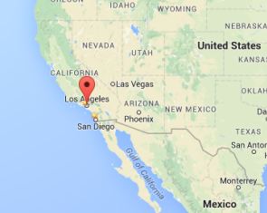
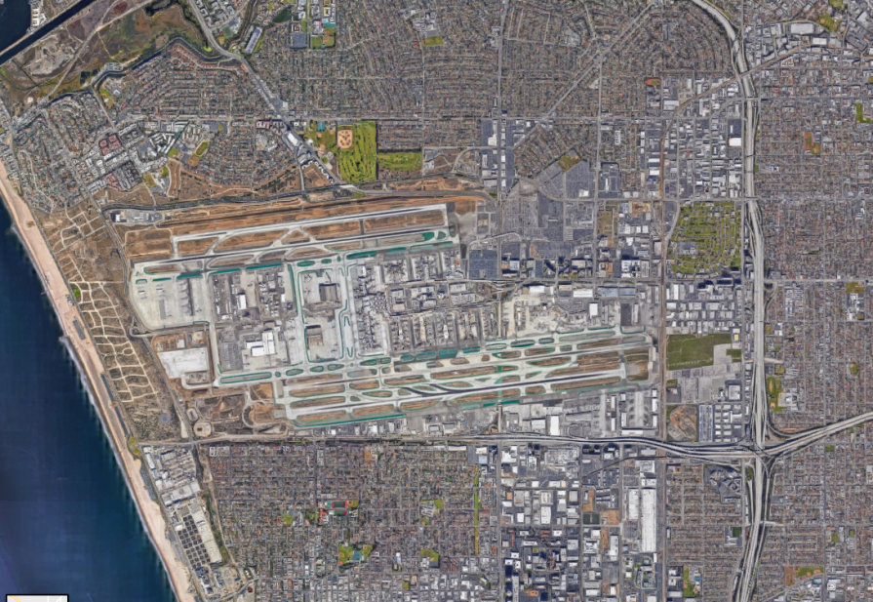
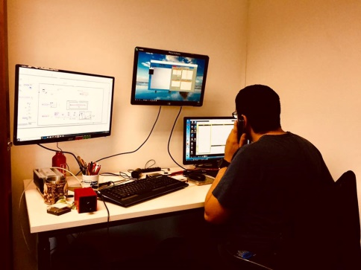

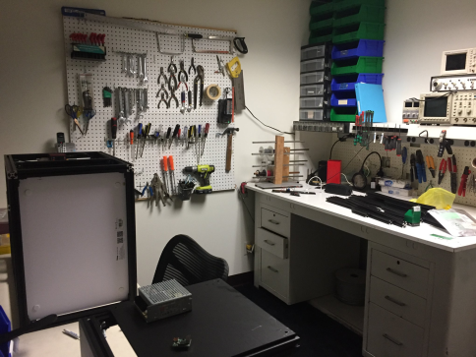
Overview of Bossa Nova Vision
BOSSA NOVA Vision, formerly BOSSA NOVA Technologies, was founded in 2018 and is located in Los Angeles, USA
BOSSA NOVA Vision is a small business of 4 people specialized in optics, electronics, imaging and software development (3 PhDs, 1 Engineer)
LAX
Los Angeles
International Airport

Slide 3



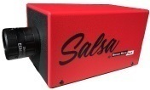

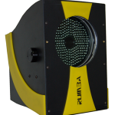
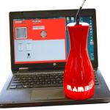
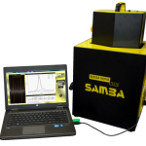
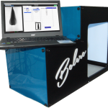
Overview of Bossa Nova Vision
Polarization cameras
We propose a polarization-difference camera and Full-Stokes polarization camera for applications ranging from robotic vision to
3D reconstruction
Cosmetic testing systems
Dedicated to claims substantiation for marketing and/or advertising, and product efficacy evaluation for R&D.
Turn-key systems that allows the measurement of various visual appearance parameters – gloss, alignment, volume, frizz, color, movement – for hair and skin care.
Public / Private R&D
We continually explore the application of innovative technologies through government (NASA, NSF, DoD, etc.) or private R&D contract to enhance the performances of our instruments and develop new inspection techniques.

Slide 4
Polarization cameras
Polarization cameras
We propose a polarization-difference camera and Full-Stokes polarization camera for applications ranging from robotic vision to
3D reconstruction
Cosmetic testing systems
Dedicated to claims substantiation for marketing and/or advertising, and product efficacy evaluation for R&D.
Turn-key systems that allows the measurement of various visual appearance parameters – gloss, alignment, volume, frizz, color, movement – for hair and skin care.
Public / Private R&D
We continually explore the application of innovative technologies through government (NASA, NSF, DoD, etc.) or private R&D contract to enhance the performances of our instruments and develop new inspection techniques.

Slide 5
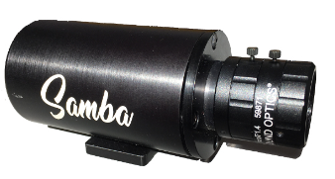
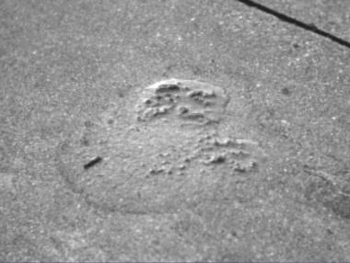
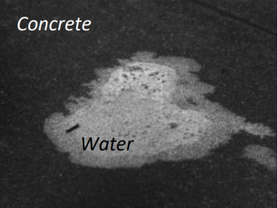
Polarization cameras
SAMBA
Polarization-difference imaging
Technology
Fast-switching liquid crystal
(camera sensor up to 70 fps)
Filtering of Parallel and Crossed reflection
Polarization difference/degree imaging at video rate
Specular
Size | 90 x 25 x 25 mm
Weight | < 300 g
Spectral bandwidth | 400-700 nm
Resolution (px) | 1024 x 1024 to 2500 x 1900
Frame Rate (Sensor) | 3 to 70 fps
Polarization contrast ratio | > 200
Bit depth | 8 to 12 bits
Diffused
Electronics
Liquid
Crystal
CCD
Lens
Results
Live polarization-difference imaging in active configuration (polarized illumination) :
S₀ and S₁ parameters
Separation of Specular and Diffuse reflection:
Shine and diffuse extraction

Slide 6
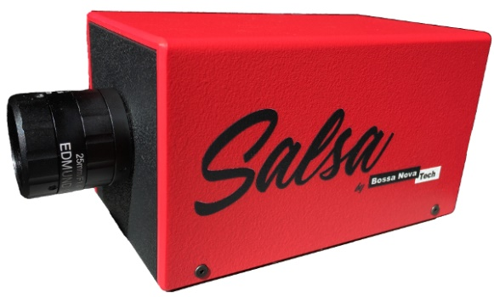
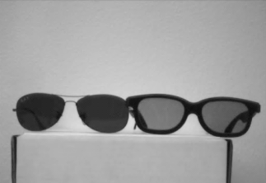
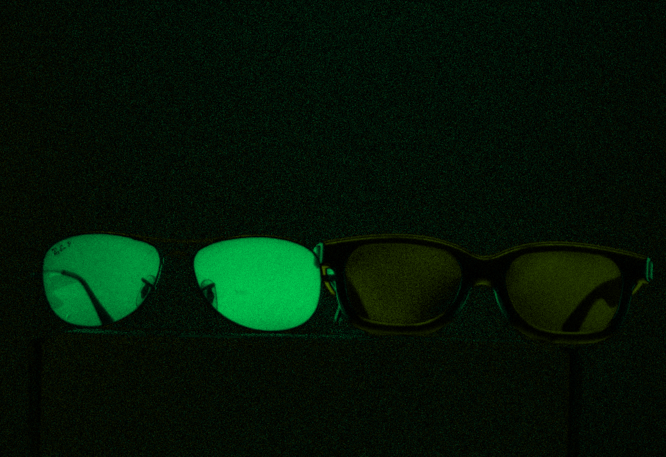
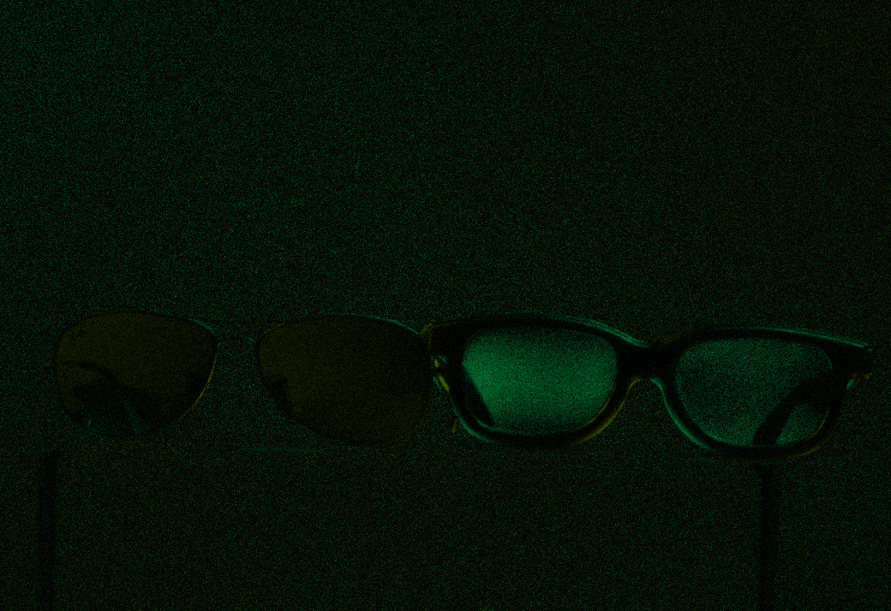
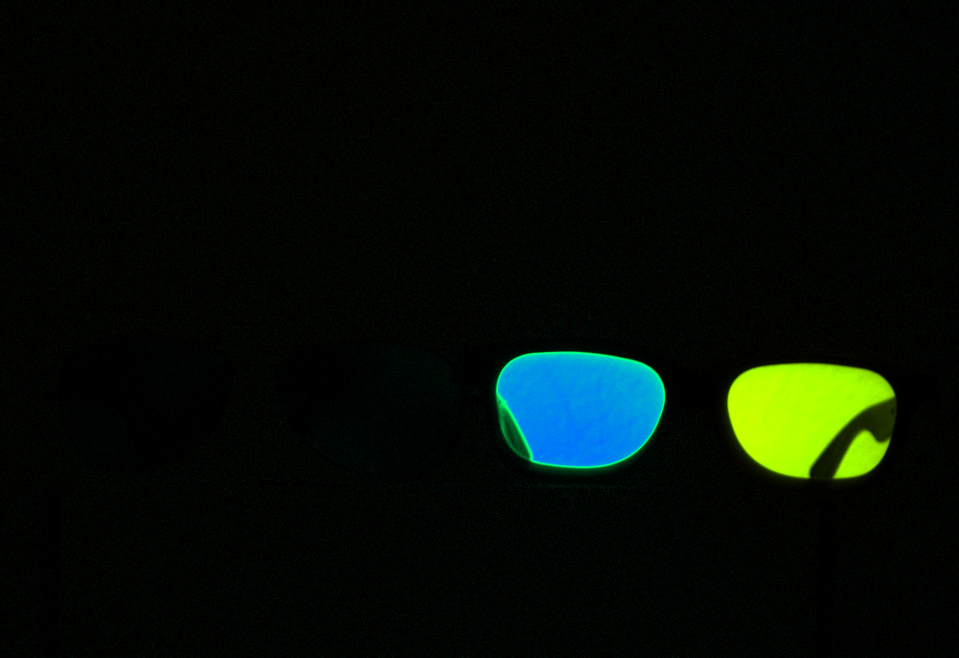
Polarization cameras
SALSA
Full Stokes polarization camera
Technology
Polarization State Analyzer (PSA)
Acquisition of 4 successive images with 4 different PSA configurations
(proprietary technology)
Reconstruction of the polarization state of the light impinging on the camera
Size | 100 x 80 x 80 mm
Weight | 700 g
Spectral bandwidth | 520-550 nm Custom in VIS
Resolution (px) | 1024 x 1024 to 1920 x 1080
Frame Rate | 12 to 20 fps
Bit depth | 8 to 12 bits
2-state retarders
Linear polarizer
S₀
S₁
Results
Complete polarization characterization
Full Stokes parameters :
S₀ S₁ S₂ S₃ parameters
Degree of polarization quantification :
DOP / DOLP / DOCP (%)
AOP / Ellipticity (degree)
S₂
S₃

Slide 7

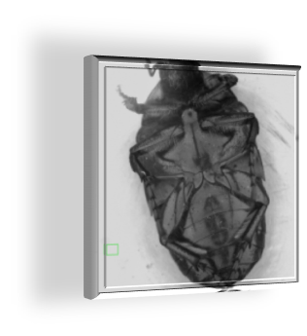
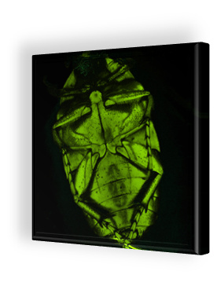
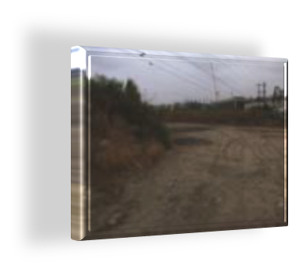
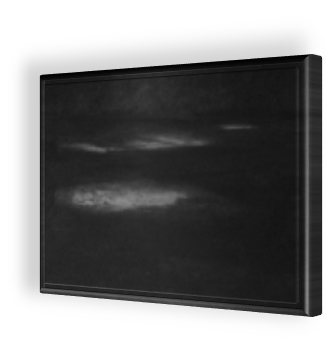
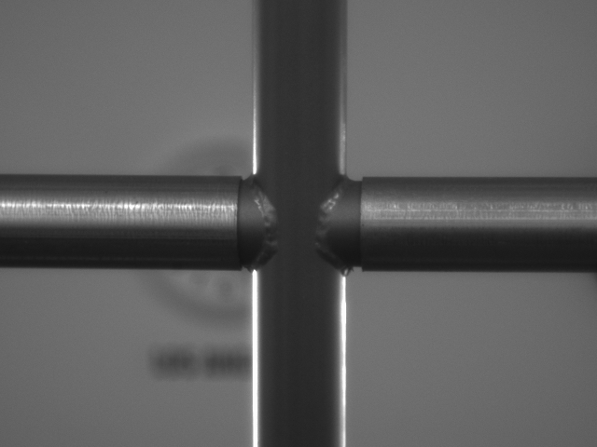
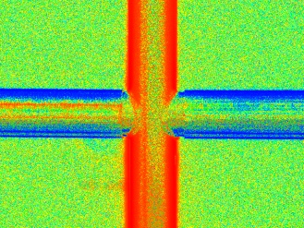
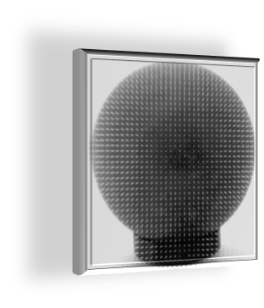
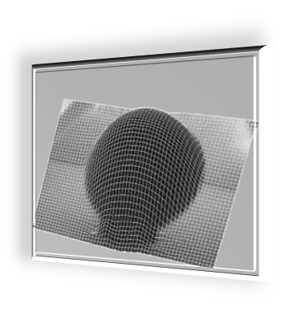
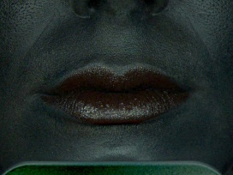
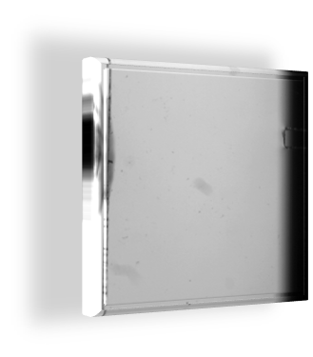
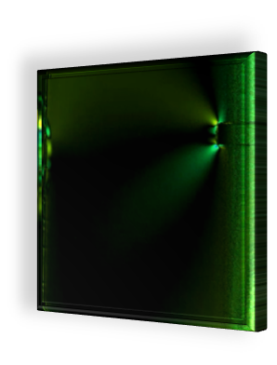
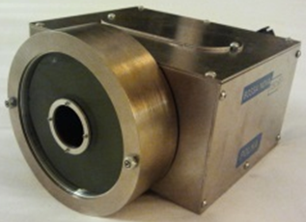
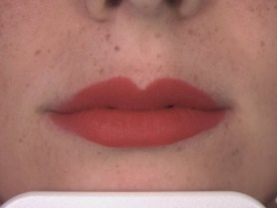
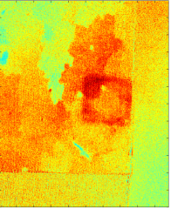
Polarization cameras
Applications
Robotics, Defense, Security, Cosmetics, Medical, Inspection, Quality Control, …
Polarization-difference
(SAMBA)
Full Stokes
(SALSA)
Steel bars
Horizontal bar (blue)
Biology
Target detection
Vertical bar (red)
POLKA
Magnetic inspection
Specular light
3D reconstruction
Diffused light
Stress mapping

Slide 8
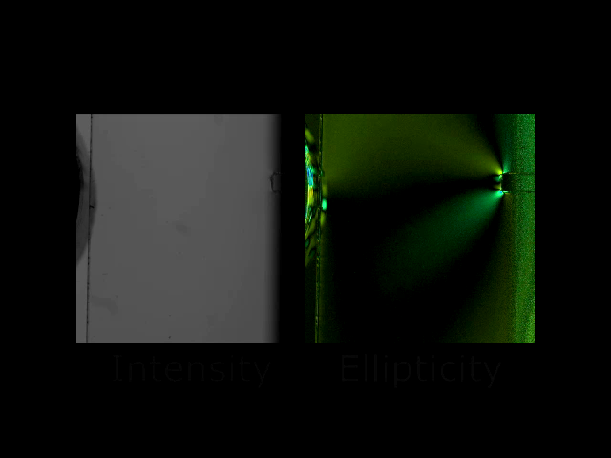
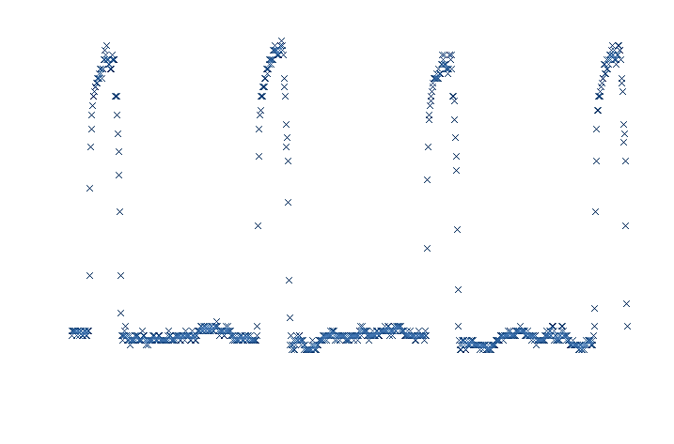
Polarization cameras
Example
Stress Application
Determination of stress pattern and intensity using the polarization
Linearly polarized illumination
Force (N)
4
0
Time
Visualization in real time of stress constraint when a
force is applied on a Plexiglas using the Salsa camera

Slide 9
Cosmetic testing systems
Polarization cameras
We propose a polarization-difference camera and Full-Stokes polarization camera for applications ranging from robotic vision to
3D reconstruction
Cosmetic testing systems
Dedicated to claims substantiation for marketing and/or advertising, and product efficacy evaluation for R&D.
Turn-key systems that allows the measurement of various visual appearance parameters – gloss, alignment, volume, frizz, color, movement – for hair and skin care.
Public / Private R&D
We continually explore the application of innovative technologies through government (NASA, NSF, DoD, etc.) or private R&D contract to enhance the performances of our instruments and develop new inspection techniques.

Slide 10
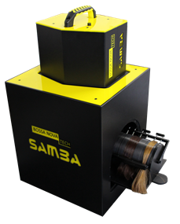
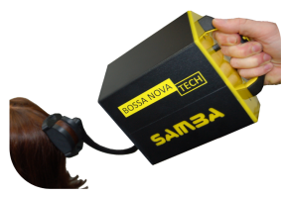
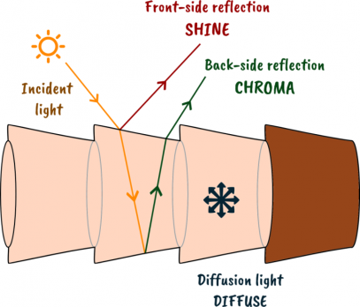
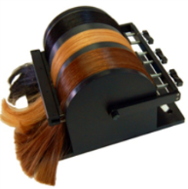
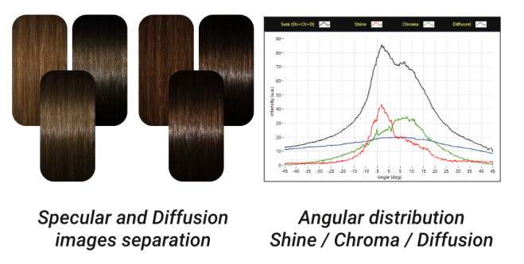
Cosmetic testing systems
SAMBA Hair
Hair Shine
System properties
Cross-polarization imaging
Specular/Diffusion separation
Combing cylinder for better repeatability
Detachable head sensor for
in-vivo evaluation
Sensor | 12bit color camera 780 x 580 px Vivo / Vitro
Illumination | White LED bar
Hair Type | Any color Straight hair 25 mm wide / 178 mm long
Data | Luster, angular profiles, images, numerical data
Size | 36 x 56 x 36 cm
Weight | 14 kg
Results
Cross-polarization imaging
Specular & Diffusion images
Standard luster calculation
BNT, Reich-Robbins, TRI, etc.
Shine / Chroma / Diffusion separation, angular profiles, profile geometry, etc.

Slide 11
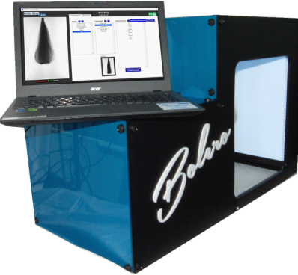
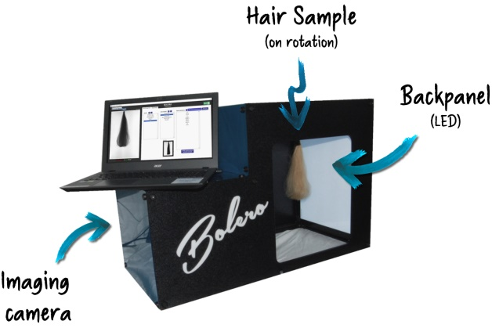
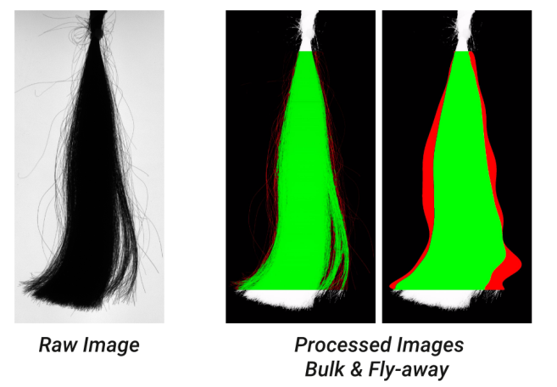
Cosmetic testing systems
BOLERO
Hair Volume & Frizz
System properties
Transmission Imaging
Bulk/Frizz separation
Hair sample rotation
36 images per sample
Magnetic fixation
Sensor | Monochrome 8 bits 2400 x 1480 px
Illumination | White LED panel
Hair Type | Any color From 5 to 25 cm 20 grams
Data | Images, 3D volume measurement & frizz analysis
Size | 75 x 50 x 38 cm
Weight | 14 kg
Results
Raw transmission images
Bulk & Frizz separation images
Volume in cm³
Frizz proportion
3D model of hair swatch

Slide 12
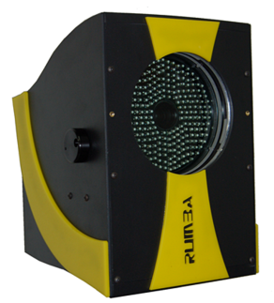
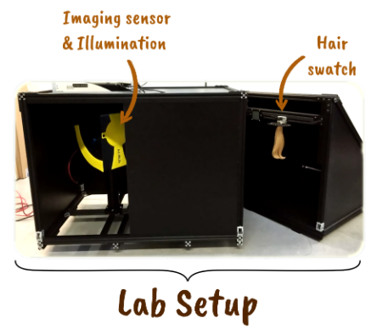
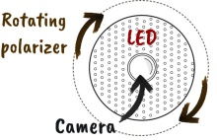
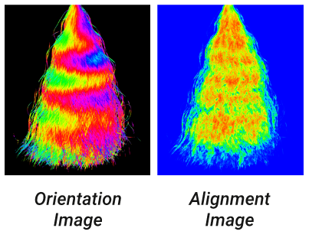
Cosmetic testing systems
RUMBA
Orientation, Straightness & Alignment
System properties
Fast polarization imaging
orientation measurement < 1 s
Any hair orientation between
- 45 / + 45 degrees
Lab setup for in-vitro
Tripod mounting for in-vivo
Sensor | Monochrome 12-bits 2330 x 1750 px Adjustable focus
Illumination | Pulsed LEDs @850 nm
Hair Type | Any color/shape Vivo/Vitro
Data | Orientation & Alignment 2D mapping, Straightness & Alignment analysis
Size (Sensor) | 25 x 23 x 18 cm
Size (Lab setup) | 185 x 65 x 80 cm
Weight (Sensor) | 5 kg
Results
Orientation image
Hair orientation distribution
Alignment mapping
Alignment & straightness analysis
Spatial analysis along swatch length

Slide 13
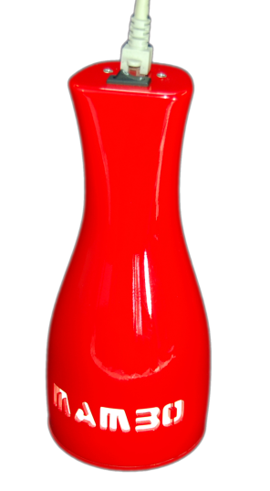
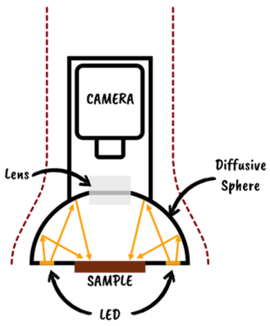
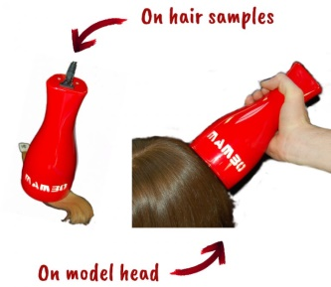
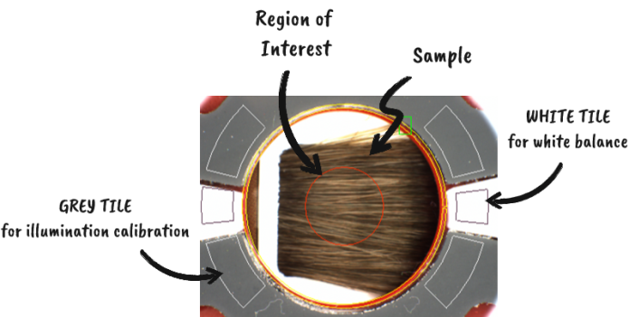
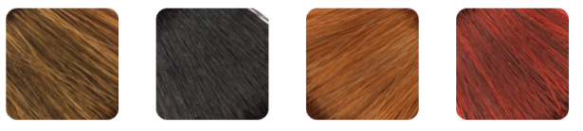
Cosmetic testing systems
MAMBO
Hair Color
System properties
Diffusive white illumination
Hand-held system
In-Vitro / In-Vivo
Instant measurement and color-matching
Sensor | Color 12 bits ROI diameter = 10 mm
Illumination | White LED Diffusive sphere
Hair Type | On Head or Swatch Min. density required
Data | RGB color values CIE* Lab 1976 color values DE* comparison
Size | 30 x 10 x 10 cm
Weight | 600 g
Results
Absolute color measurement
RGB / Lab*
Database comparison
Color matching
DE* with reference color

Slide 14



Cosmetic testing systems
SAMBA Face
Skin Gloss
System properties
Cross-polarization imaging
Specular/Diffusion separation
Real-time image visualization
Interchangeable lens (C-mount)
Adjustable chinrest
Sensor | Color 12 bits 1900 x 1900 px 166 x 116 mm² FOV
Illumination | 5600K Daylight LED Ring
Holder | Adjustable chinrest 7 orientations
Data | Specular / Diffusion Images, Gloss histogram
Size | 76 x 41 x 56 cm
Weight | 13 kg
Results
Cross-polarization imaging
Specular & Diffusion images
Gloss mapping
Gloss histogram on user-specific ROI

Slide 15



Cosmetic testing systems
BOLERO MONO
Fiber Diameter & Ellipticity
System properties
High resolution transmission Imaging
Auto-centering and focusing
Hair sample rotation
18 images per sample
Measurement time < 2 min
Sensor | Monochrome 8 bits 4024 x 3036 px 2.6 x 2 mm² FOV
Illumination | White LED panel
Fiber | Any color Diameter - 5 to 500 μm Bare or crimped
Data | Raw images Diameter / Ellipticity 3D model
Size | 36 x 41 x 23 cm
Weight | 10 kg
Results
Raw B&W images
Diameter and Ellipticity
Variations along fiber length
3d model of fiber

Slide 16




Cosmetic testing systems
On-going
development
TANGO
Freely aligned
hair shine analysis
Chroma and shine
image acquisition
BOLERO Lite
Entry-level, simple, cost-effective
transmission imaging system
HULA
Hair Motion
Quantifying
Hair Motion Trefor A. Evans , Sebastien Breugnot
Journal of the Society of Cosmetic Chemists, Vol. 69, No. 5, 371-382

Slide 17
Public / Private R&D
Polarization cameras
We propose a polarization-difference camera and Full-Stokes polarization camera for applications ranging from robotic vision to
3D reconstruction
Cosmetic testing systems
Dedicated to claims substantiation for marketing and/or advertising, and product efficacy evaluation for R&D.
Turn-key systems that allows the measurement of various visual appearance parameters – gloss, alignment, volume, frizz, color, movement – for hair and skin care.
Public / Private R&D
We continually explore the application of innovative technologies through government (NASA, NSF, DoD, etc.) or private R&D contract to enhance the performances of our instruments and develop new inspection techniques.

Slide 18

Public / Private R&D
Public / Private R&D
We continually explore the application of innovative technologies through government (NASA, NSF, DoD, etc.) or private R&D contract to enhance the performances of our instruments and develop new inspection techniques.
Public R&D Federal grants
Focused on Federal Research/Research and Development Type of grants Small Business Innovation Research (SBIR) : support scientific excellence and technological innovation through the investment of Federal research funds in critical American priorities Increase private-sector commercialization of innovations Small Business Technology Transfer (STTR) : Similar to SBIR, but includes incentives to foster the expansion of the public/private sector partnership requirement for the small business to formally collaborate with a research institution
Private R&D Sub-contract testing & development
Testing We can be sub-contracted to do some testing application in order to : figure out if our systems can be used for this specific application to establish a testing process to determine the next step towards the development of an appropriate system We do not provide with large-scale cosmetic testing, but we can refer to some companies that use our systems for this purpose (TRI Princeton, SP Equation, etc.) Product development We can be sub-contracted for product development regarding : Inclusion/adaptation of our technologies into a product for a specific application Adaptation of our systems regarding a specific testing process or methodology Development of a new system/measurement technique that needs our expertise (polarization, vision, image processing, etc.)

Slide 19





Public / Private R&D
R&D history
(non-exhaustive)
2006
2006
2010
2014
2018
SBIR* Army - SALSA
Fast rotatable and variable ceramic programmable wave-plate for visible and NIR polarization imaging Department of Defense Grant : $729,515 Patent # US 8,004,675 B2
SBIR* NSF - POLKA
High Dynamic, Alignment Free Metrological Method for 3D Shape Measurement of Optical Surfaces Based on Polarization National Science Foundation Grant : $598,184
SPEquation – BOLERO Mono
Hair fiber diameter and ellipticity optical measurement Partner : SP Equation, France
P&G – TANGO & RUMBA
In Vivo measurement of Shine/Chroma/Diffused and Hair Fiber orientation Partner : Procter & Gamble, USA Patent # US 8,223,322 B2
eSalon – MAMBO
Hand-held hair color measurement system Partner : eSalon, USA
* SBIR = Small Business Innovation Research (Funds granted by public US federal agencies)

Slide 20
Thank you !
For further questions
feel free to contact us :
5777 W. Century Blvd
Suite 205 - LOS ANGELES
CA 90045 USA
Tel: +1 (424)-393-4011
Fax: +1 (310) 943-3280
www.bossanovavision.com
info@bossanovavision.com

