Slide 1
The AxoScan™ Ellipsometer
Overview
January 2015

Slide 2
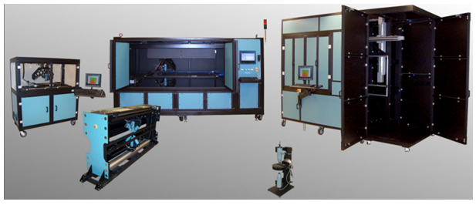
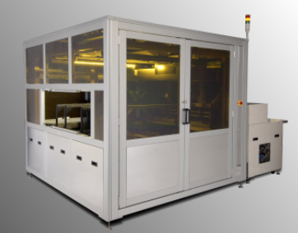
Axometrics
Founded in 2002
Huntsville, Alabama, U.S.A
A world leader in polarized light optical measurement systems
Primary focus has been the LCD industry

Slide 3

















Key Customers
Many hundreds of systems throughout the world

Slide 4
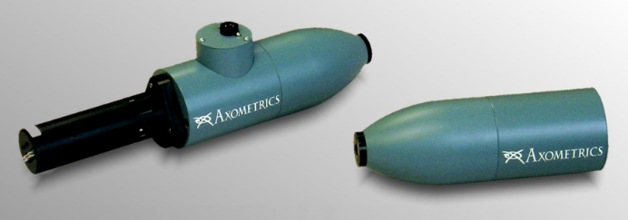
AxoScan
AxoScan™ is the most trust polarization measurement system in the world.
Measures the full Mueller matrix of a sample in 30 ms
Used heavily in LCD industry since 2002
  LCD panel cell gap, twist angle, rubbing direction, pre-tilt
  Polarizer films and retardation films
  3D display components

Slide 5
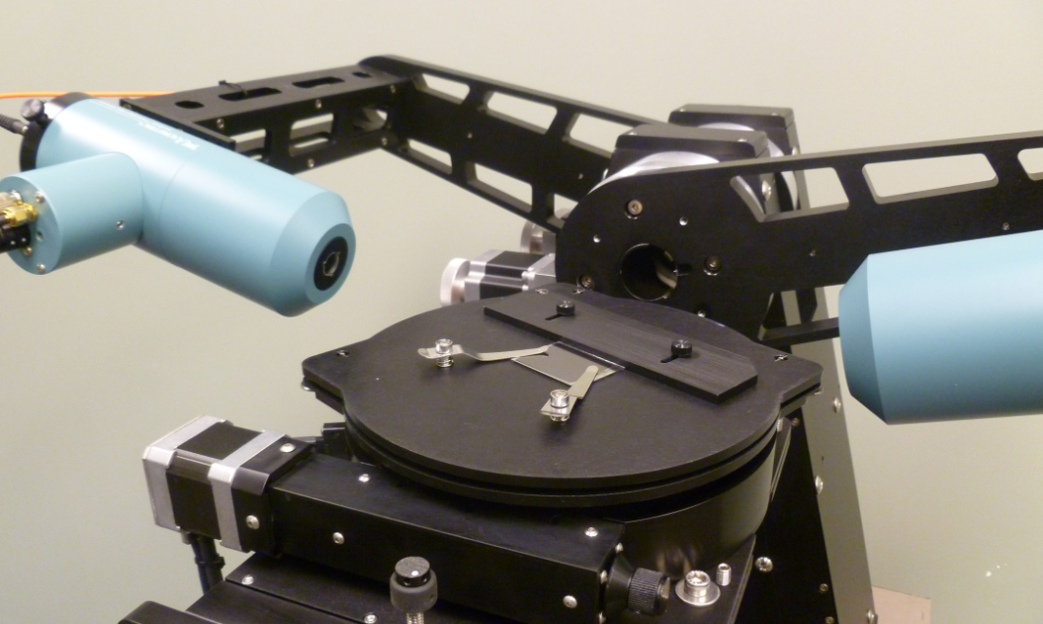
AxoScan Ellipsometer
In 2014, display companies in Japan, Taiwan, and China began using the new AxoScan Ellipsometer system

Slide 6
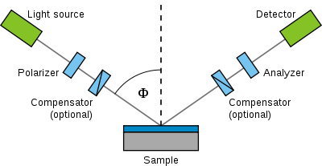
Ellipsometry Overview
Ellipsometry is an indirect way to measure the thickness of thin films
Steps:
  Measure how sample changes polarization of reflected light
  Determine the parameters by Ψ and Δ
  Use curve-fitting to match a mathematical model of film layers to the measurement

Slide 7
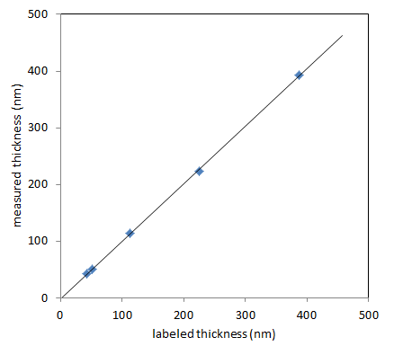
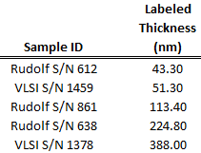
AxoScan Measurements
Example measurements of SiO2 on Si thickness measurements

Slide 8
Why AxoScan?
There are many ellipsometer systems in the world market. Why choose AxoScan?
AxoScan features:
  Extremely high speed – only 30 mm per measurement point required
  Full Mueller matrix – allows generalized ellipsometry of anisotropic and transparent materials
There are some applications where AxoScan Features offers significant advantages

Slide 9
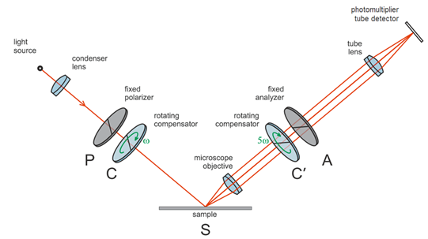
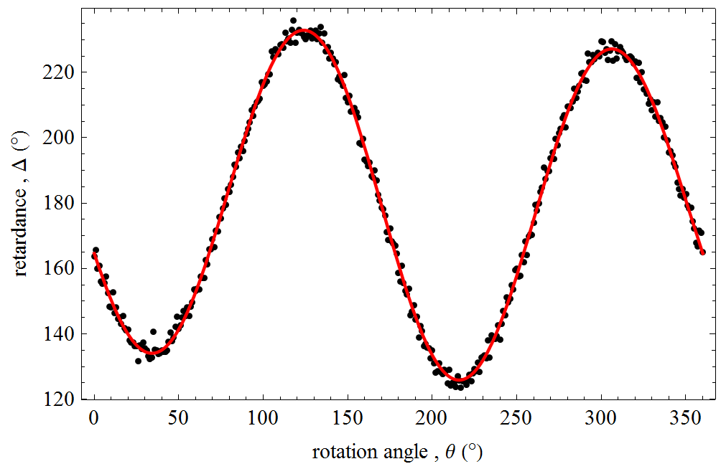
Aniostropic Polyimide on Glass
Measuring thickness and anisotropy of PI on glass was not practical with previous ellipsometer systems
Axometrics developed this application working closely with several display companies
Installed onto production lines in 2014 and 2015

Slide 10
Other Applications
Working with companies to develop other new solutions
Especially cases where traditional ellipsometer systems sometimes fail:
  Scattering and depolarizing samples
  Coatings on transparent substrates
  Anisotropic coatings or substrates
  Harsh environments were alignment and contamination are problems
  High-speed applications such as inline measurements for web coating

Slide 11
Summary
The AxoScan system is the most powerful polarization measurement system in the world
AxoScan is seeking partners to develop new ellipsometry measurements where previous techniques fail

