Slide 1
LC Alignment Layer Measurement
Using the AxoScan™ VVRM and VRTF Systems

Slide 2
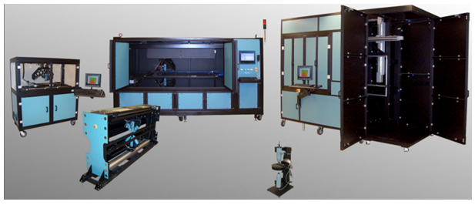
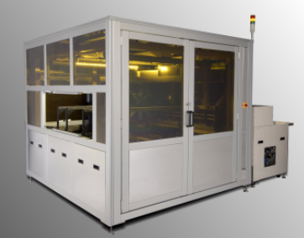
Axometrics
Founded in 2002
Huntsville, Alabama, U.S.A
A world leader in polarized light optical measurement systems
Primary focus is the LCD industry
Hundreds of systems shipped throughout Asia

Slide 3
Contents
Basic Overview of PI Testing
The AxoScan System
Analysis Methods
Ellipsometry
Generalized Ellipsometry
Fast Mueller Matrix Method
Sample Data
Lab Systems and Production Systems

Slide 4
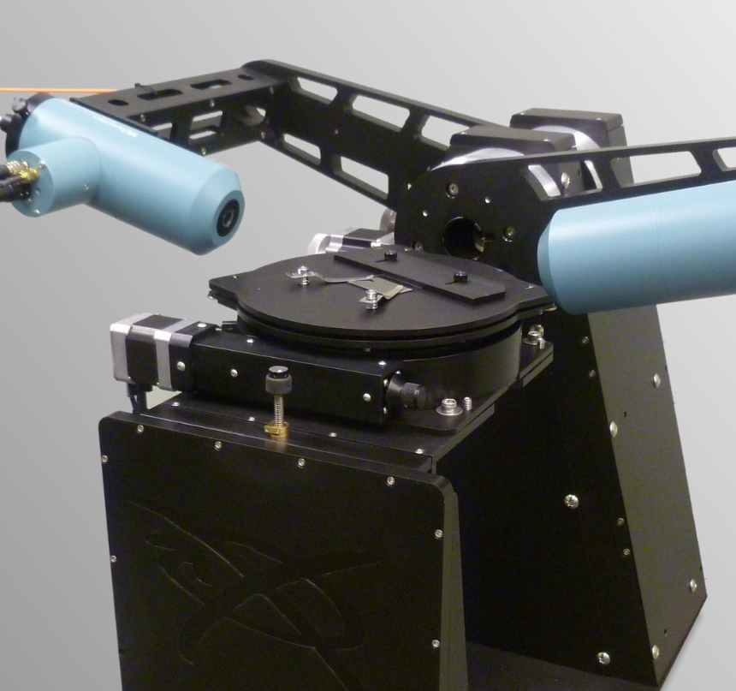
LC Alignment Layer Measurements
Use the AxoScan™ system for testing LC alignment layers
Layer types
PI (isotropic)
Rubbed PI
Photo-aligned PI (PAPI)
Measurement parameters:
Film thickness
Alignment direction
Alignment strength (anisotropy)
Tilt angle

Slide 5
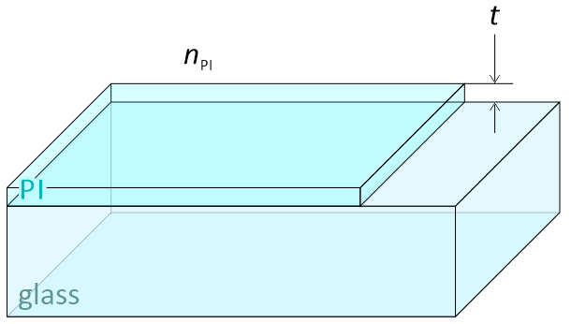
PI Film Testing
Polyimide (PI) film on bare glass
Before photo-alignment or rubbing, PI is isotropic
Isotropic means the refractive index n is the same in all directions
AxoScan will measure the thickness t and refractive index n of the PI film

Slide 6
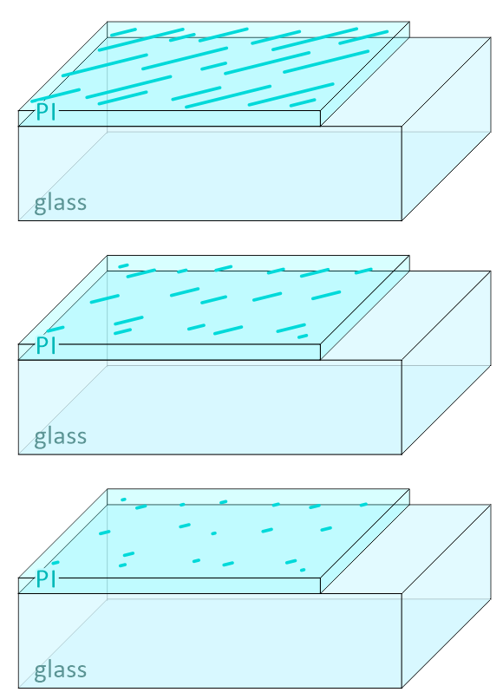
Anisotropy
Large Δn
High exposure strength
Strong anchoring energy
When PI is photo-aligned or rubbed, it becomes anisotropic
Refractive index n is different depending on direction
Δn = n_{max} - n_{min}
The anisotropy, Δn, is proportional to the photo-alignment exposure strength (or rubbing strength) and azimuthal anchoring energy
Increasing exposure energy
Small Δn
Low exposure strength
Weak anchoring energy

Slide 7
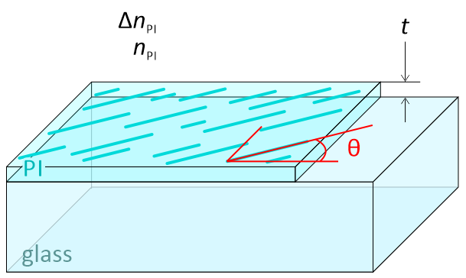
Anisotropy Orientation
An anisotropic film will have a its maximum refractive index, n_{max}, aligned in some direction, θ
The anisotropy orientation, θ, is proportional to the photo-alignment polarizer angle (or rubbing direction)
LC molecules will align in this direction
In the same direction as
the photo-alignment direction
or rubbing direction

Slide 8
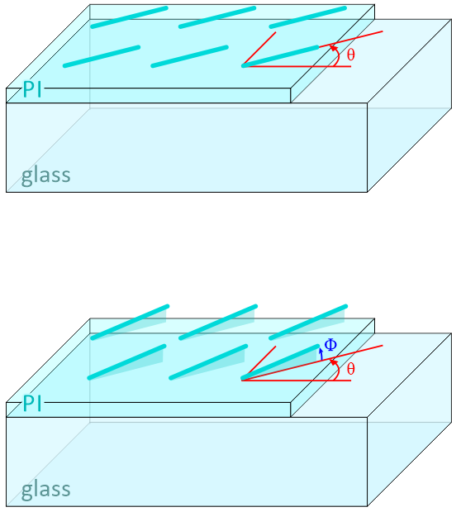
Anisotropy Tilt Angle
For photo-aligned PI, the anisotropy tends to lay flat
LC molecules will have 0° pre-tilt angle
For rubbed PI, the anisotropy can be tilted up (away from the glass) by an angle Φ
This is will cause LC molecules to have a pre-tilt angle > 0°
Photo-aligned PI usually has no tilt angle
Rubbed PI has a tilt angle Φ

Slide 9


Complex Refractive Index
Sometimes, refractive index is a complex number, $\tilde{n}$
It is possible for anisotropy to have both Δn and Δk
Real part
n describes how fast light moves through the material.
Usually just called the “refractive index”.
$$\tilde{n}=n+ik$$
Imaginary part
k describes how light is absorbed by the material.
If k = 0, the material is perfectly clear.
Sometimes k is called the “absorption coefficient”.

Slide 10
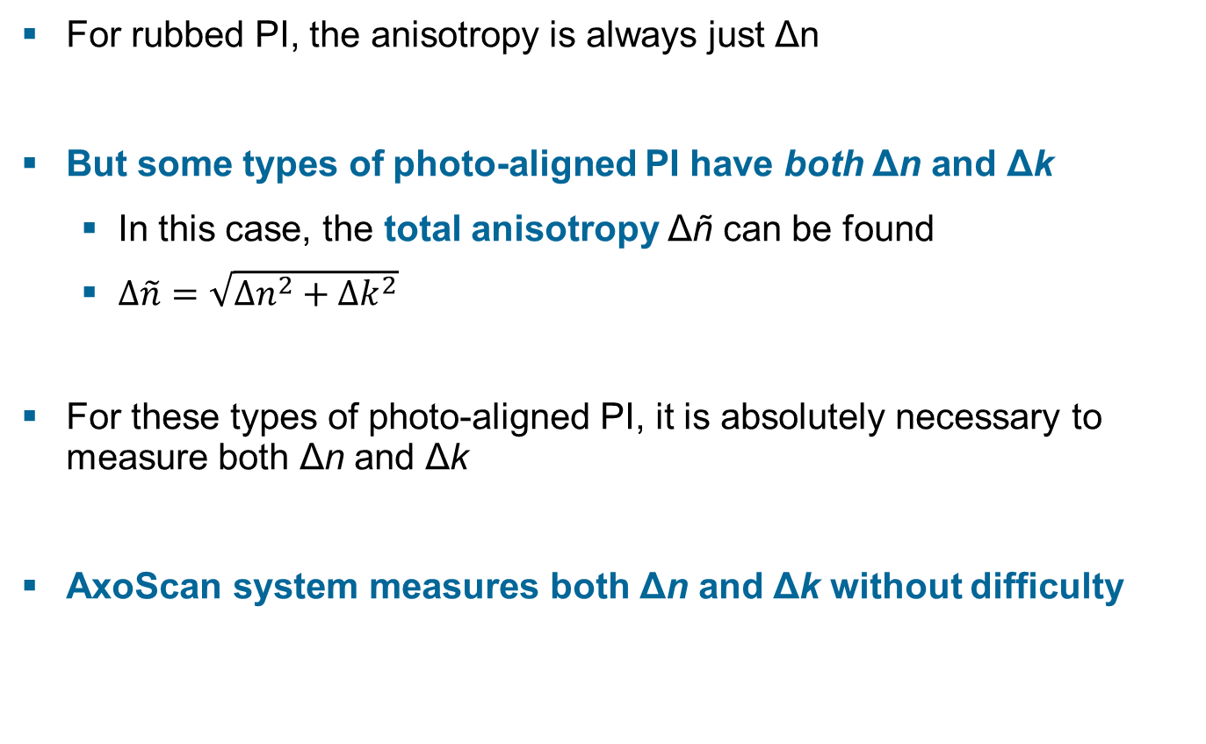
Complex Refractive Index – Cont.
For rubbed PI, the anisotropy is always just Δn
But some types of photo-aligned PI have both Δn and Δk
In this case, the total anisotropy Δñ can be found
$∆\tilde{n}=\sqrt{∆n^{2}+∆k^{2}}$
For these types of photo-aligned PI, it is absolutely necessary to measure both Δn and Δk
AxoScan system measures both Δn and Δk without difficulty

Slide 11
Two Analysis Methods
Two different analysis methods depending on the sample type:
Generalized Ellipsometry (GE)
Industry-standard technique for characterizing anisotropic thin films
Actual measurement of thickness, anisotropy, orientation, and tilt
Can be used when the layer structure is simple and uniform
This is the preferred technique
Fast Mueller Matrix Method (FMMM)
Developed by Axometrics (Patent Pending)
Actual measurement of orientation, relative measurement of orientation and tilt
Can be used on complex and pixelated layers
AxoScan performs GE and FMMM at the same speed!

Slide 12
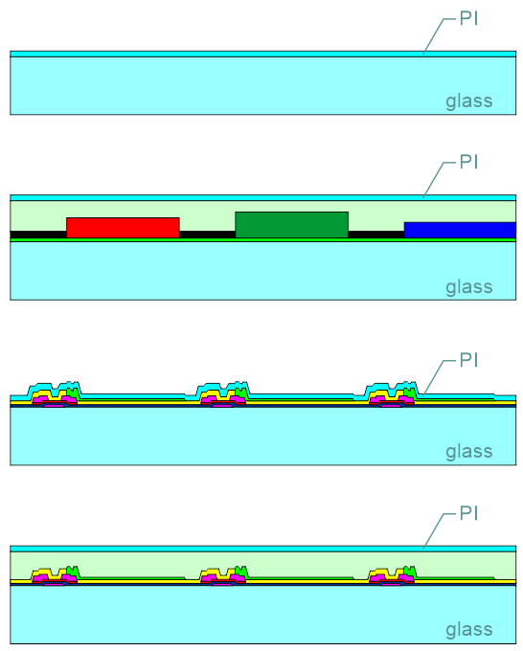
Sample Types
PI on dummy glass, or on areas between cells
PI on CF glass active area
PI on TFT glass active area
PI on TFT glass active area with planarization layer

Slide 13
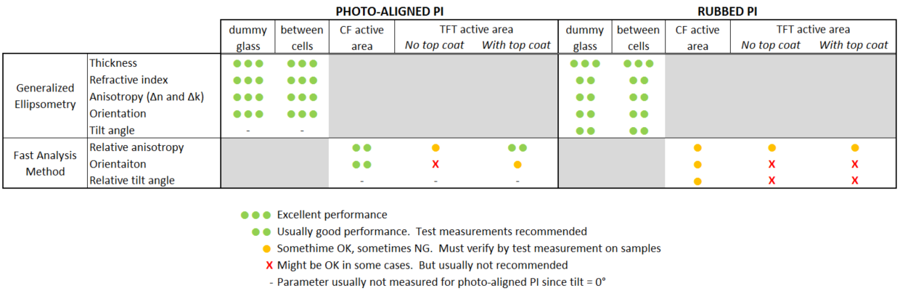
AxoScan Capabilities
Measurement performance depends strongly on sample type
Pixel geometry, PI material, exposure / rubbing strength, etc.
See the following are guidelines. Note that testing on actual customer samples is always recommended.

Slide 14
Typical Specifications
Typical measurement specification in cases where excellent performance can be achieve:
Measurement time: 30 s
Thickness: 3σ = 0.1 nm
Anisotropy: 3σ = 0.5% CV
Anisotropy orientation: 3σ = 0.1°
Measurement performance is strongly affected by factors including pixel geometry, PI material, exposure / rubbing strength, etc.
Please consider sending samples to Axometrics for testing

Slide 15
Contents
Basic Overview of PI Testing
The AxoScan System
Analysis Methods
Ellipsometry
Generalized Ellipsometry
Fast Mueller Matrix Method
Sample Data
Lab Systems and Production Systems

Slide 16
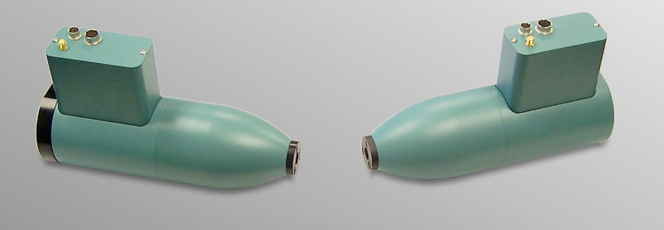
AxoScan-HSO
System uses the AxoScan sensor for the high-sensitivity option (HSO)
Uses photo-multiplier tube detection due to low light level from glass reflection

Slide 17
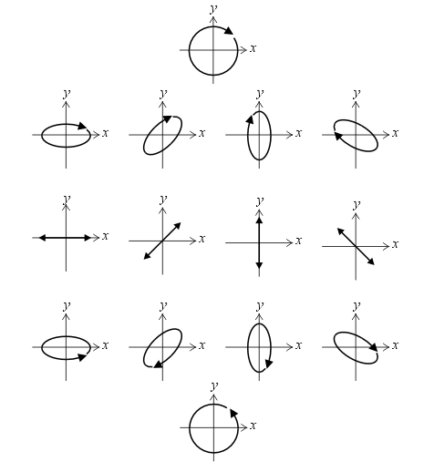
Polarization State Possibilities
Polarization state of light can be an arbitrary ellipse
Circular
Elliptical
Linear
Clockwise rotation
Right-handed
Counterclockwise rotation
Left-handed
right-hand
rotation
linear
left-hand
rotation

Slide 18
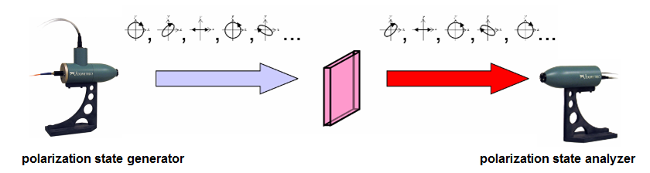
AxoScan Sensor Theory
Test the sample with 120 different polarization states in 30 ms
All types of states:
Linear polarization, Elliptical polarization, Left-Handed and Right-Handed

Slide 19
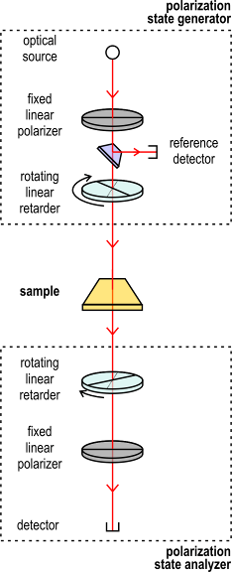
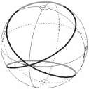
AxoScan Sensor Theory – Continued
Fixed polarizer followed by a rotating retarder generates these polarization states:
A rotating retarder followed by a fixed polarizer analyzes states after the sample
Analyzer retarder rotates five times faster than the generator.
Provides a sufficient variety polarization states to calculate the Mueller matrix

Slide 20
AxoScan Sensor Theory – Continued
Mathematics for calculating the Mueller matrix:
Creates N polarization states with a known Stokes vector S_{n}
Each S_{n} interacts with the unknown Mueller matrix M
Then they interact with known Stokes vector A_{n} of the analyzer
Then measure the intensity P_{n} for each of the n states
Each measured intensity is defined by the dot product:
P_{n} = (A_{n})^{T}·M·S_{n}
Use linear algebra technique (matrix pseudo-inverse) to find M
Full details can be found here:
R. A. Chipman, Polarimetry, Ch. 22 in Handbook of Optics Vol. II, 2nd Ed.,
M. Bass ed., McGraw-Hill, New York, 1995.

Slide 21
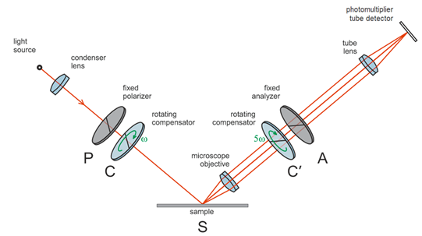
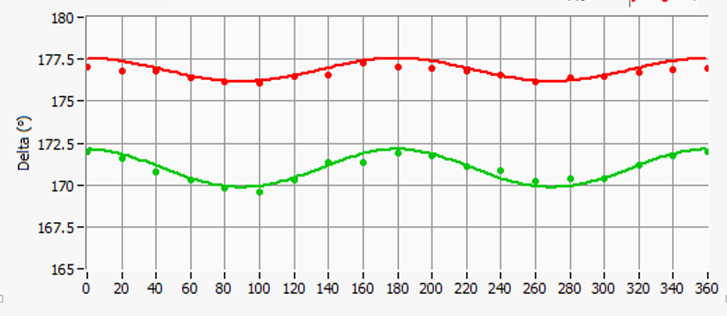
Measurement Technique
Typical measurement recipe:
Measure the Mueller matrix
Rotate the sample by 20° and measure the Mueller matrix again
Repeat 19 times until reaching full 360° rotation
Perform either GE or FMMM analysis
Requires 30 seconds

Slide 22
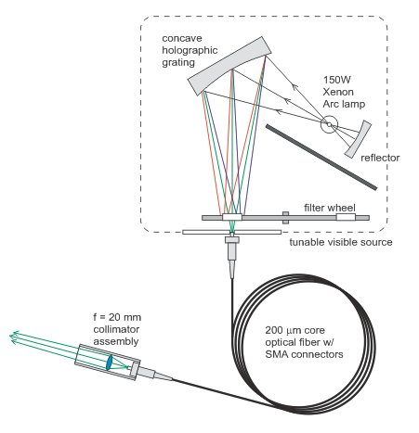
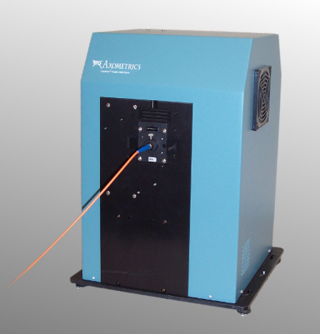
Tunable Visible Source
Tune any wavelength 400 ~ 800 nm. Important if samples have multiple layers
Incoherent (non-laser) light removes interference problems

Slide 23

Spot Size
AxoScan uses either 3 mm optical beam standard
Average value of several pixels
No focusing needed
No precision alignment needed
Using incoherent light source (not laser) reduces problems with interference fringes and diffraction
Other spot sizes:
1 mm spot is available as an option
Variable spot size down to 100 µm is available as an option

Slide 24
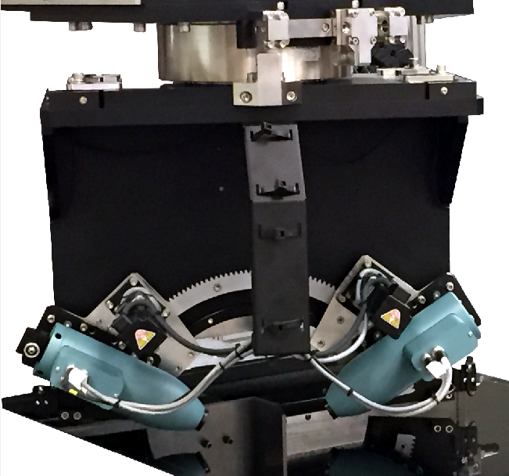
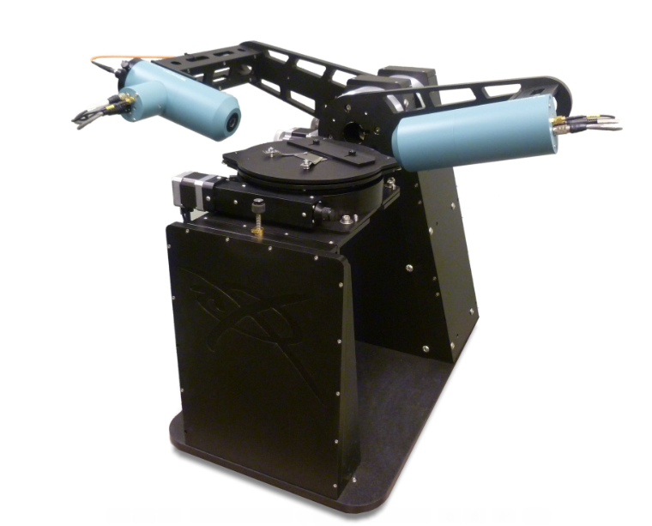
System Configurations
AxoScan VRTM
Desktop system
Sample stage rotation
Up to 6-inch (150 mm) samples
AxoScan VVRM
Measurement head rotation
Large sample sizes possible
20”, 42”, 65”, …
Gen 4, Gen 5, Gen 6, …

Slide 25
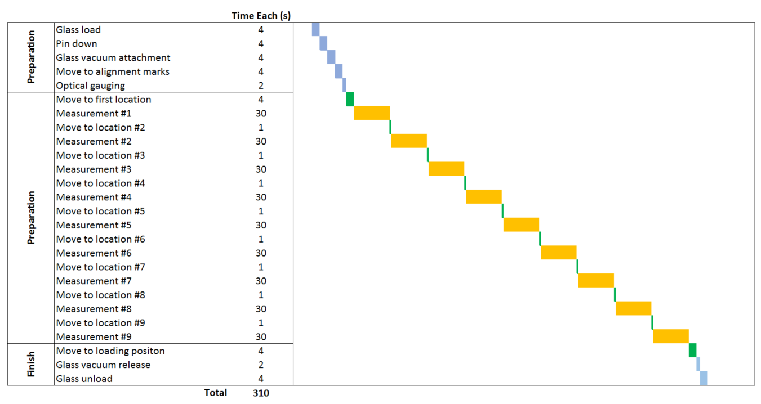
Tact Time
No time to focus or re-center between measurements is needed
Typical tact time chart for 9 measurement locations:

Slide 26
Contents
Basic Overview of PI Testing
The AxoScan System
Analysis Methods
Ellipsometry
Generalized Ellipsometry
Fast Mueller Matrix Method
Sample Data
Lab Systems and Production Systems

Slide 27
Ellipsometry
Polarization of light changes when reflected from thin films on sample
Complicated equations describe how the polarization changes due to thickness (t) and refractive index (n and k) of each thin film layer
By measuring the polarization change, we can calculate t, n, and k of each layer

Slide 28
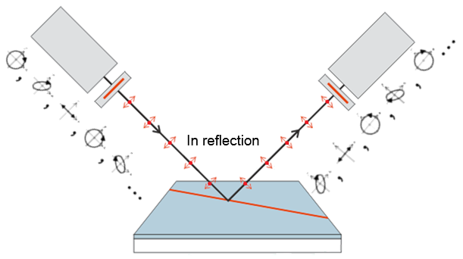
Generalized Ellipsometry
Regular ellipsometry requires the sample layers to be isotropic
But photo-aligned or rubbed PI are anisotropic
Generalized Ellipsometry (GE) is an extension of standard ellipsometry that allows for anisotropic layers
GE requires a more complicated polarization measurement
This is no problem for AxoScan since the full Mueller matrix is acquired in 30 ms.

Slide 29
Fast Mueller Matrix Method
Generalized Ellipsometry (GE) is the preferred measurement
AxoScan can make full GE measurements as fast as other company’s simple measurement technique!
So GE is always possible on dummy glass
But sometimes the GE method is very difficult:
If layers structure is too thick or too complicated
If sample is patterned (like TFT or CF active area)
In those cases, Axometrics created the Fast Mueller Matrix Method (FMMM)

Slide 30
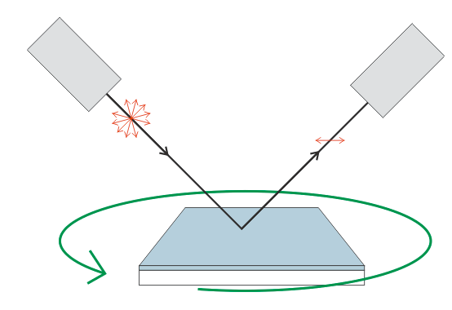
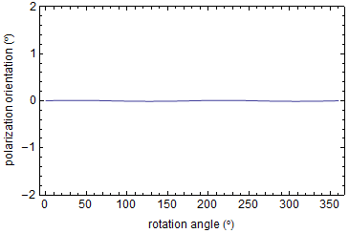
Fast Mueller Matrix Method – Cont.
If you rotate the isotropic sample, the reflected polarization signal always remains parallel to the glass (0°)

Slide 31
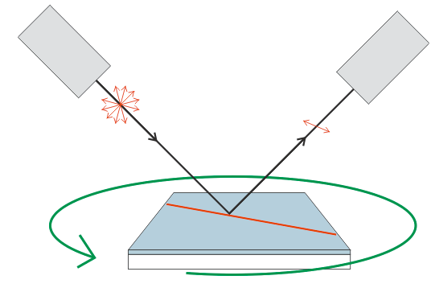
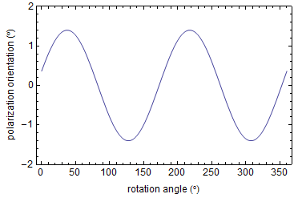
Fast Mueller Matrix Method – Cont.
But for an anisotropic sample, the polarization signal will change when the sample is rotated

Slide 32
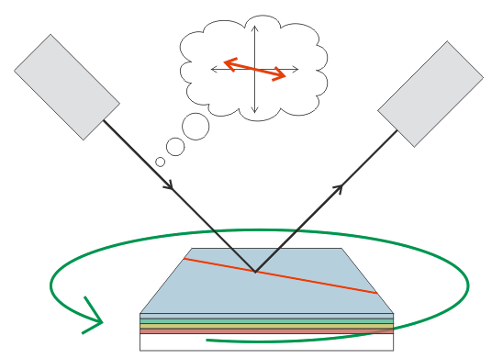
Fast Mueller Matrix Method – Cont.
Use Diattenuation Orientation (θ_{ψ})/Retardance (δ) vs. Rotation Angle
“Which input polarization state has maximum reflectivity/phase shift?”
Reflection from air-PI interface dominates measurement
Not strongly affected by other thin-films and active area

Slide 33
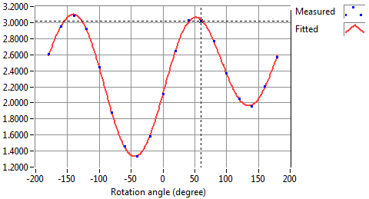


Fast Mueller Matrix Method – Cont.
Fit a simple model function to the measurements
$\text{θ}\text{Ψ}\text{ =} \text{A} \text{+} \text{B} \text{sin}\text{( 2}\text{θ} \text{+} \text{φ}\text{B}\text{ )} \text{+} \text{C} \text{sin}\text{( }\text{θ} \text{+} \text{φ}\text{C}\text{ )}$
φ_{B} = alignment direction, φ
B ∝ anisotropy, Δn
C ∝ pre-tilt
Diattenuation orientation, $θΨ$ (°)

Slide 34
Key Advantage
AxoScan can make full ellipsometry measurements as fast as other company’s simple measurement technique

Slide 35
Contents
Basic Overview of PI Testing
The AxoScan System
Analysis Methods
Ellipsometry
Generalized Ellipsometry
Fast Mueller Matrix Method
Sample Data
Lab Systems and Production Systems

Slide 36
Photo-Aligned PI on Dummy Glass
See that Δn and Δk do not vary linearly with exposure energy!
This is only true for some types of PI material
But total anisotropy is a good indicator of exposure energy
Analysis by GE method is absolutely needed for this sample!

Slide 37
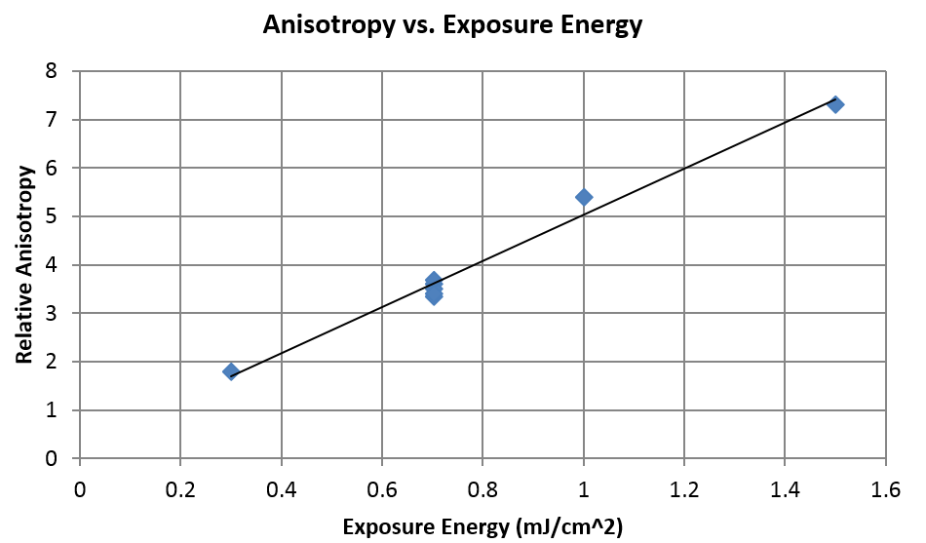
Photo-Aligned PI on TFT Glass
Relative anisotropy measurements of photo-aligned PI on production panel TFT glass
Analyzed by FMMM

Slide 38
Relative Anisotropy of Rubbed PI
Rubbed PI on production panel, CF glass
Measurement of relative anisotropy for different rubbing conditions
Rubbing parameters | Relative Anisotropy
Stage Speed 15 | 0.62 | Higher stage speed, Larger Anisotropy
Stage Speed 25 | 0.53
Mark Width 13.5 | 0.32 | Wider mark, Larger Anisotropy
Mark Width 17.5 | 0.69
RPM 1200 | 0.59 | Higher roller speed, Larger Anisotropy
RPM 1600 | 0.82

Slide 39
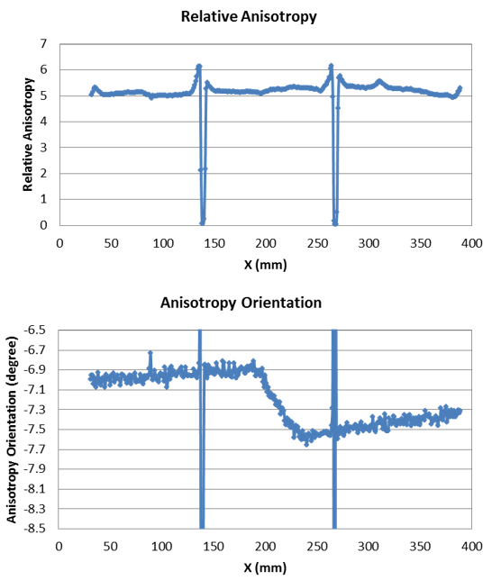
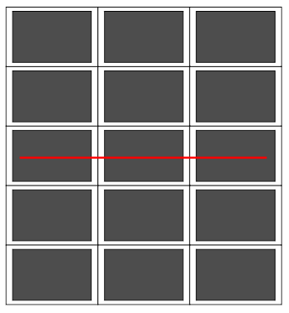
High-Resolution Photo-Aligned PI Test
Production CF glass, FMMM test
Scan across 3 cells on a motherglass
Traverse direction
Notice the 0.3° change in orientation in the transition region

Slide 40
Contents
Basic Overview of PI Testing
The AxoScan System
Analysis Methods
Ellipsometry
Generalized Ellipsometry
Fast Mueller Matrix Method
Sample Data
Lab Systems and Production Systems

Slide 41
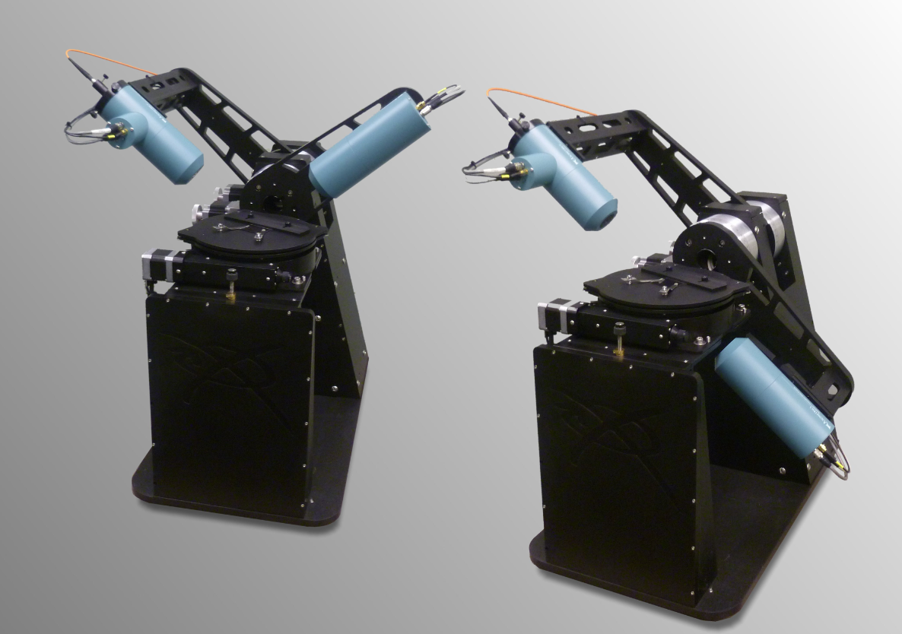
VRTF-1 Lab System
Lab system for samples up to 6”

Slide 42
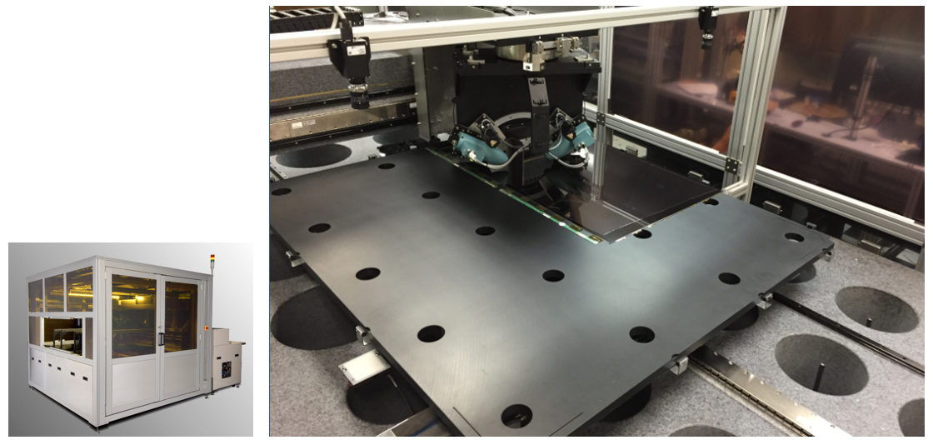
VVRM
Systems for testing mother glass or cut cells
G4.5
G5
G5.5
G6
Offline in inline operation

